Slide 1
Data Security & PCI-DSS Compliance in Cloud & Virtual Data Centers (vDCs)
Data Security in a Cloudy World
Sangeeta Anand
General Manager & Corporate Vice President, Data Protection
Sangeeta.anand@safenet-inc.com
October 2012

Slide 2
Introduction
Cloud & vDC Data Security Challenges
PCI Version 2.0 & Encryption for Data Security
Recommended Steps
SafeNet Inc.
Notes:
Presentation outline; ‘Today’s threat landscape, emerging European regulations combined with new technologies are impacting the way banks are delivering services to their customers.
How can we take advantage of this market intelligence to protect information, provide innovative services and deliver efficiencies to the business?’

Slide 3
“Let’s Move to Virtualization / Cloud!”…
So why aren’t they saving more!?
Cloud Saves Money!
Enterprise cloud spending is estimated to grow from $15B in 2011 to $53B in 2014.
Overall investment in cloud security is projected to grow Into a $1.5 billion market by 2015.

Slide 4
Anatomy of the Cloud and Virtualization
Application Presentation & APIs
Application Engine
Data Engine & Platform APIs
Middleware
Software
as a Service
Virtualization APIs
Platform
as a Service
Infrastructure
as a Service
Hardware & Networking
Power & HVAC
Architecture
Sample Vendors
Service
Notes:
Need to animate

Slide 5
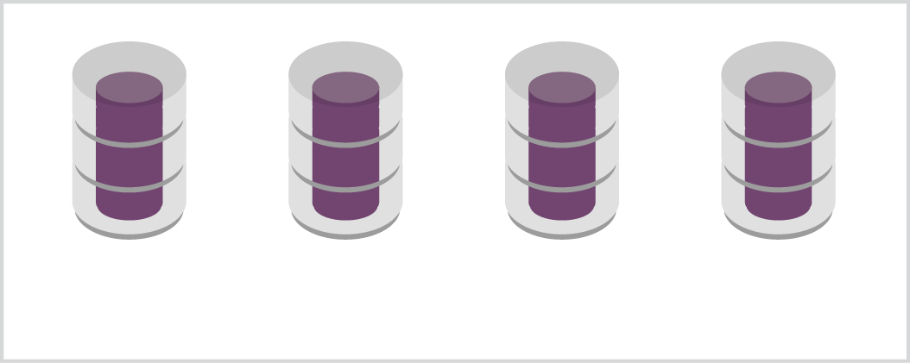
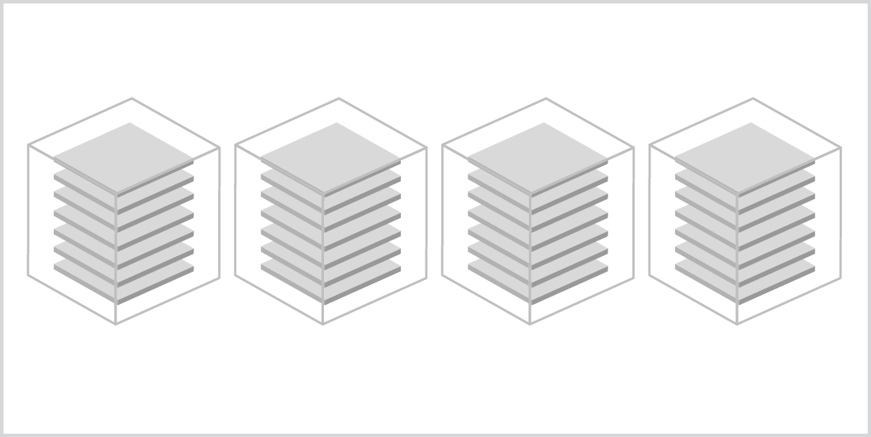
Anatomy of a Dense Virtual Infrastructure
The hypervisor enables each physical host (compute power) to host multiple virtual guests (VMs)
VMware ESXi
Xen (e.g. AWS)
Each management plane may span across multiple physical hosts
Storage can be directly attached, SAN or NAS
APP
APP
APP
APP
Mgmt
Plane
OS
OS
OS
OS
Hypervisor
Compute Layer
Storage
Snapshots
Snapshots
Backup

Slide 6
Losing Control in a Virtual World?
VMs are easy to copy (and steal.)
APP
APP
APP
APP
OS
OS
OS
OS
VMs are easy to move.
Hypervisor
VMs introduce a new class of privileged users and administrators—server, storage, backup, and application—all operating independently.
Compute Layer
Storage
VMs have multiple instances, snapshots and backups of data.
Snapshots
Snapshots
Shredding data capability if data at risk or switch providers
Backup

Slide 7
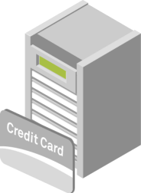
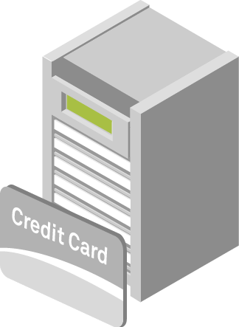
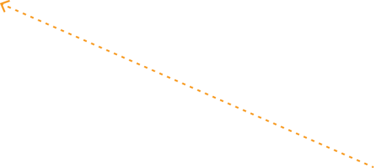
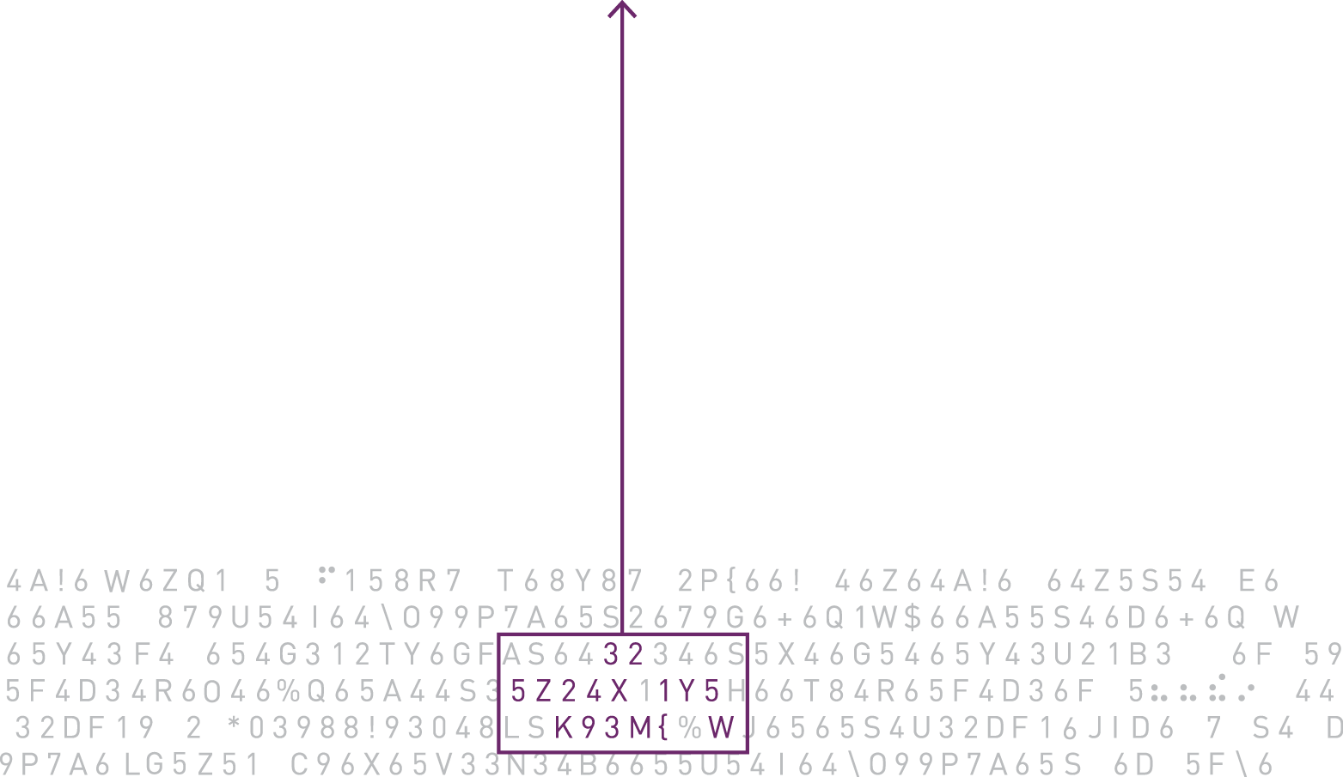
Cloud Migration
VMs introduce a new class of privileged users and administrators—server, storage, backup, and application—all operating independently.
Data ownership and governance in an untrusted environment
Lawful surrender of data
Shredding data capability if data at risk or switch providers
E-commerce
App server
Cloud/Virtual
Administrators
(can manage VMs)
Payment info or other sensitive data
Cloud/Virtual
Administrators
Internal Admins
Users
Notes:
- crawling to the cloud with localized initiatives such as testing or development
- ad-hoc initiatives to fulfil a specific business need in a cost effective and adgile way (compared with setting up a new env in IT)
- more organized migration of specific sites to the cloud (e.g. Deutsche Post)
- full-blown migration to the cloud to save cost (less common today)
We should then BRIEFLY mention the related issues.
Migration to the cloud
Could be specific apps, specific implementations or complete infrastructure
Multi tenancy
Cloud admins
Lawful surrender of data
Data ownership & governance in an untrusted environment
Ability to shred data in the case of moving to another provider or at risk of exposure
- ad-hoc initiatives to fulfil a specific business need in a cost effective and adgile way (compared with setting up a new env in IT)
- more organized migration of specific sites to the cloud (e.g. Deutsche Post)
- full-blown migration to the cloud to save cost (less common today)
We should then BRIEFLY mention the related issues.

Slide 8
Key Data Security Concerns in vDCs & Cloud Environment
Data Governance
Lack of Visibility
Do I know where all my data instances are?
Can I trace every legitimate replication/copy/instantiation event of my data?
Can I trace unauthorized copying of my data?
Data Compliance
Lack of Data Control
Who is accessing my data?
Can I enforce an effective access control policy?
Can I present a trusted audit trail of all access events to my data?
Data Security
Risk of Breach and Data Loss
Are all my data instances secure?
Can I assure only authorized access to my data?
Can I “pull the plug” on data that’s at risk of exposure?

Slide 9
Data Security Concerns Stall Virtualizationn/ Cloud Adoption
IT Security is stopping projects. Compliance/Audit has tons of questions. Cloud and Virtualization growth IS being limited.
IT Security Group: The cloud isn’t secure. I don’t trust Providers. I don’t know how to secure that thing!
Compliance Audit Group: Show me your security. Prove compliance in Clouds. Convince me!
Notes:
Cloud and Virtualization Adoption
For all the market momentum surrounding the cloud and virtualization technologies, one thing remains abundantly clear: these environments present significant security implications which cannot be ignored. Organizations across the globe are embarking onto the cloud and virtualization journey seeking to take advantage of the performance, cost savings and on-demand scalability that cloud delivery models offer, however these advantages comes with a price, they pose some security issues and potential risks which need to be mitigated, addressed with careful advanced planning and proof is provided to satisfy compliance auditors requirements.

Slide 10
PCI 3.4 Addresses Data Security in Virtualized / Cloud Environments
PCI 1.0: 2004
Encryption Data (Section 3.4)
IT: Huge issues in data discovery
PCI 1.1: 2006
Key Management clarifications, Compensating Controls
IT: Needed time to comply, begin using compensating controls
PCI 1.2: 2008
More Key Management clarifications
IT: Better use of encryption, issues with Key Management compliance, compensating controls in use
PCI 2.0: 2011
Clarifications on virtualization
Some organizations have achieved PCI compliance using compensating controls for the data protection. Compensating controls assume physical ownership and isolation as risk mitigation strategy. IaaS will drive re-thinking of risk mitigation without physical control.

Slide 11
PCI DSS Virtualization Guidelines: Section 3
Best practices on encryption and key management
Moving Sensitive Data in the cloud
Separation of duties – to prevent access by unauthorized personnel
Keys do not co-exist with encrypted data
Virtualized Key Management functions/components do not co-exist with the encrypted virtual host
Notes:
PCI DSS Virtualization Guidelines: Section 3
1.Some of the virtualization considerations, as well as being present in known locations, cardholder data could exist in archived, off-line or dormant VM images or be unknowingly moved between virtual systems.
2. Sensitive data such as unencrypted PAN, sensitive authentication data and cryptographic keys could be inadvertently captured in active memory and replicated via VM snapshot functions.
3. Privileged accounts or processes running on the host or hypervisor could inadvertently be granted access to cryptographic keys from within a hosted component.
4. Separating logical access to encrypted file systems from accounts across all virtual layers adds additional levels of complexity.
Additional Best practices
Do not virtualize critical resources used in the generation of cryptographic keys (for example, physical FIPS modules)
If key management functions are virtualized, do not house virtual components that perform key-management functions or store cryptographic keys on the same hypervisor or host as the virtual components that store or access data protected by these keys.

Slide 12
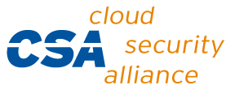
PCI Compliance Drives Encryption in Cloud & vDCs
The cloud changes everything
Multiple uses for a virtual resource that contains sensitive data make it difficult to apply the needed controls
The cloud changes nothing
Every rule of a mandate still applies when migrating sensitive data to the cloud
Many infrastructure roles and responsibilities may drop out of view, but compliance responsibility remains with you
Encryption is becoming a fundamental technology for protecting data in the cloud:
Isolation of data in multi-tenant environments
Separation of duties
Role and policy based access
Notes:
A compliance infrastructure also needs to be flexible, so that it can accommodate shifting business models and environments.
For example virtualization. The cloud have changed everything, but in fact changes nothing.
Every rule of a compliance mandate still applies to sensitive data,
And although visibility is reduced in the cloud, the responsibility of data ownership and compliance remains w/ you
Encryption is fast becoming a fundamental technology for protecting data and enabling compliance in the cloud.
Extending your unified encryption foundation and management into the cloud ensures the requirements of compliance are met - isolation of data, separation of duties, and role and policy based access.

Slide 13
Why Encryption ?
Principle | Trust/Ownership | Hypervisor | Disclosure/Visibility | Issues
Limit use of <sensitive data> |  |  | X | Big issue in SaaS, in your control for the most part in IaaS and PaaS
Use secure development practices |  |  | X | Issue in SaaS and PaaS
Control access to <sensitive data> | X | X | X | Issues in all cases. Issues of user identification, authorization rights, privileged cloud user
Encrypt <sensitive data> in transit |  |  | X | Most likely already addressed, but customer to cloud, intracloud communication can be an issue
Optional <sensitive data> encrypt at rest | X |  | X | Huge issue in data sitting in the cloud, across all platforms.
Keep <sensitive data> confidential | X | X | X | Main issue is guaranteeing the “trust” in data when you don’t “trust” the cloud.
Keep the integrity of <sensitive data> | X | X | X | Main issue is guaranteeing the “trust” in data when you don’t “trust” the cloud.
Enforce separation of duties of <sensitive data> access and administration | X | X | X | Fundemenal issue of cloud employee and cloud administrator access. Extends to both physical and logical security. Invokes separation of duties issues around all controls.
Report and audit your controls for |  |  | X | Can you prove it to your auditor.
Encryption enables authentication and authorization layer.
Encryption directly addresses many regulator requirements. Shows high standard of care.
Encryption fundamentally isolates your data from other tenants in a share cloud environment, shields from unauthorized data breach.
Encryption inherently provides for integrity controls.
Encryption can add additional authentication and authorization layer for users and administrators. Customer owned encryption definitively shows separation from cloud.
Encryption Key ownership is tangible proof to data ownership. Encrypt/Decrypt actions become easy log and audit proofs.
Notes:
How does encryption help?
We talked about encryption as strategic enabler to mitigate security risks while moving sensitive data into virtualized and cloud environment.
Question is “how does encryption help?”
I have the same slide where I explained various principles and issues. Now I am going to describe how encryption addresses these issues.
Control access to <sensitive data> ---- Encryption enables authentication and authorization layer.
Optional <sensitive data> encrypt at rest ---- Encryption directly addresses many regulatory requirements. Shows high standard of care.
Keep <sensitive data> confidential ---- Encryption fundamentally isolates your data from other tenants in a share cloud environment, shields from unauthorized data breach.
Keep the integrity of <sensitive data> ---- Encryption inherently provides for integrity controls.
Enforce separation of duties of <sensitive data> access and administration ---- Encryption can add additional authentication and authorization layer for users and administrators. Customer owned encryption definitively shows separation from cloud.
Report and audit your controls ---- Encryption Key ownership is tangible proof to data ownership. Encrypt/Decrypt actions become easy log and audit proofs.

Slide 14
Encryption Accelerates Move to Virtualized DC / Cloud
Physical Location Issues of Cloud / Virtualized
Data
Destruction of Virtualized /Cloud Data
“Lawful Order” to Cloud Provider for Data
Notes:
Lawful Order
Issue: Cloud provider may turn over your data when another member of the cloud is under criminal investigation. Your data is now viewable to law enforcement.
Resolution: Encrypted data unviewable by law enforcement. Law enforcement would have to work through legal channels, under which you have guaranteed rights, to get you to turn over decryption keys.
Distruction of Cloud Data
Issue: Is data in the cloud ever destroyed? Are you sure?
Resolution: Encryption makes data unusable in the cloud. “Key shredding” virtually makes encrypted cloud data unrecoverable
Physical Location of Cloud data
Issue: Is cloud data now in new physical locations requiring new regulatory insight, or violates existing regulatory law?
Resolution: Encrypted data can be moved anywhere in the cloud, but controlled decryption with proper key release policy can define what localities may use data.

Slide 15
Agenda
Cloud & vDC Data Security Challenges
PCI Version 2.0 & Encryption for Data Security
Recommended Steps
SafeNet Inc.
Notes:
Presentation outline; ‘Today’s threat landscape, emerging European regulations combined with new technologies are impacting the way banks are delivering services to their customers.
How can we take advantage of this market intelligence to protect information, provide innovative services and deliver efficiencies to the business?’

Slide 16
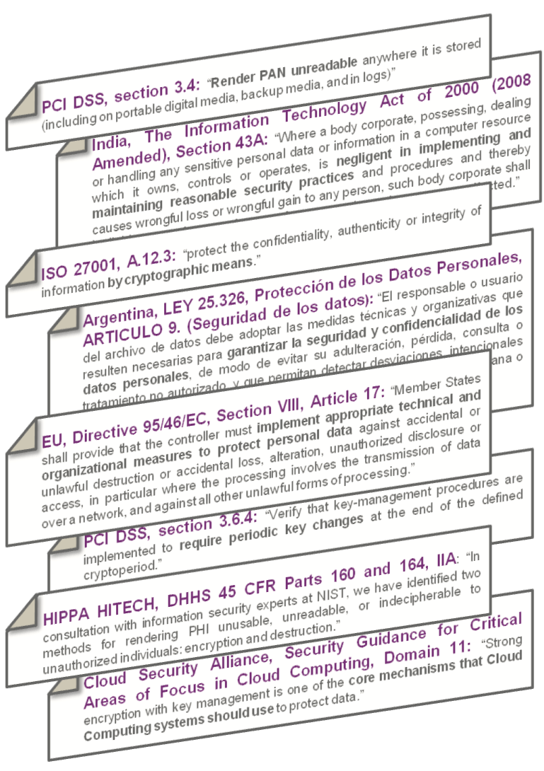
Step 1: Commit to Build a Compliant Data Secure Infrastructure
Many Regulations and Many Controls
Unified Framework Regulatory Framework
Common Data Protection Mandates
Limit use of confidential data
Control access to confidential data
Guarantee confidentiality of confidential data
Maintain the integrity of confidential data
Enforce administrator separation of duties on systems confidential data
Maintain audit and log records of confidential data activities
All regulations are based on the same confidentiality and integrity goals
* P-V-C is Physical, Virtual, Cloud
Notes:
When you address mandates individually, the supporting infrastructure and controls you put in place also tends to be done in pockets or silos. This adds cost, complexity, and audit challenge as mandates changes and evolve.
What is important to understand is that most regulations share common confidentiality or integrity requirements that are addressed by encryption, OR they specifically call for encryption.
By STARTING with a unified data-centric foundation built on encryption
And establishing a framework standard controls,
New mandates can be added, existing mandates can be evolved, all built on a controlled and standardized platform.
This delivers better scale, reduced complexity, and improved control over infrastructure and process.

Slide 17
Step 2: Use Multi Level Encryption Aligning PCI 3.4 in IaaS & Virtual Environments
Use Instance & Storage Encryption
Isolation data in multi-tenant clouds
Reduce overall exposed footprint, minimize surface area of leaks
Enforce separation of duties requirements
Data level encryption
Database and application encryption solutions enable security policies to be more granularly applied to specific subsets of data
Secures data as it progresses through workflows, and represents an ideal complement to instance encryption
Re-Examine System Data Encryption
Eliminate reliance on compensating controls
Use data encryption to manage data lifecycle risks
Take advantage in advances in system encryption when architecting IaaS based applications

Slide 18
Step 3: Use Key Mgmt to Address PCI DSS section 3.5 & 3.6
Use Customer-owned Key Management Strategically
Definitive proof of ownership and control to auditors
Adhere to proper key storage requirements (Section 3.5/6)
Use standards like NIST 800-57 and OASIS KMIP
Use Advanced Key Management Appliances & Hardware Security Modules
Store cryptographic keys in secure, purpose-built devices
Key themselves encrypted
Streamline activities like key rotation and deletion
Ensures the highest level of security

Slide 19
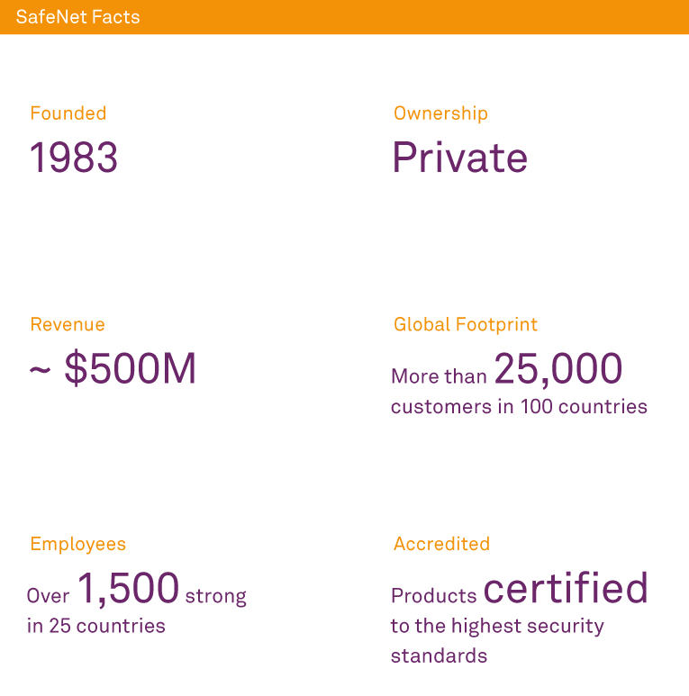
SafeNet Inc …Who are we?
Protect High Value Information in the Worlds Most Complex Environments
Solutions for Cloud and Virtualization Security
Solutions for Compliance and Data Governance
Solutions for Identity and Transaction Security
Notes:
Who we are?
SafeNet is one of the top 3 pure play Information Security companies in the world, exclusively focused on the protection of high value information in physical, virtual and cloud environment.
We deliver comprehensive data protection solutions for the persistent protection of high value information.
And we are protecting today the most sensitive, most valuable information of some of the world’s most trusted brands. Our data protection solutions are helping companies in various industry verticals like Financials, manufacuring, e-Commerce in order to achieve:
Drive new business models
Painlessly scale their infrastructure without disrupting protection
Take advantage of new deployment models like cloud
And remain compliant as they grow.
We’ve been around for 25 years – we have more than 25,000 customers in 100 countries
We’ve got 1500 employees around the world and close to to 500m in revenues
When it comes to trust, SafeNet is a proven player in both the Fortune 1000 Enterprise, and the US Government.
We protect the most money that moves in the world - securing more than 1 trillion dollars a day in interbank transfers.

Slide 20
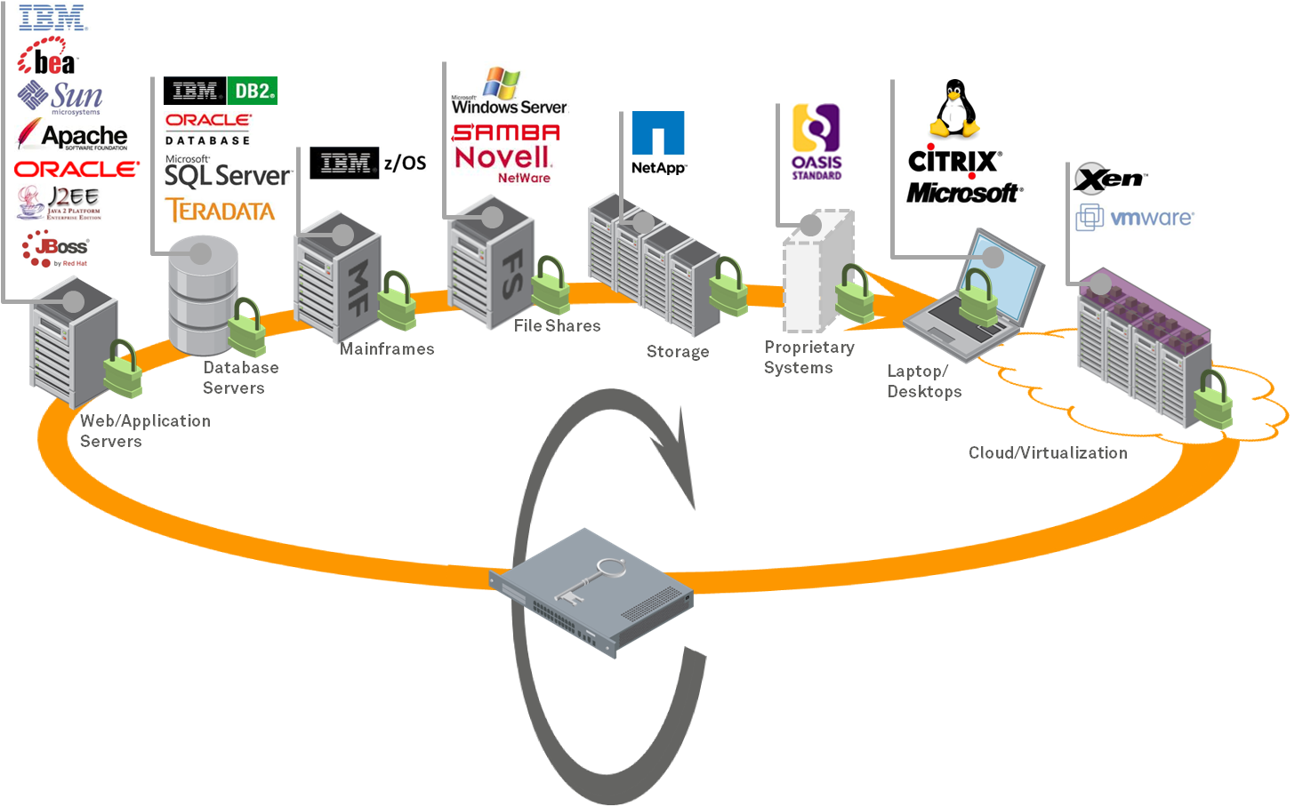
SafeNet Delivers A Compliance Infrastructure….Unifying control of data
Unified Environment
Unified encryption across multiple tiers
Across multiple vendor platforms
Centralized policy enforcement
Central key management
Logging and auditing
Role-based controls
Notes:
Now let’s look at the centralized and data-centric approach of a compliance infrastructure
Unified encryption and management controls are in place across multiple tiers – database, storage, applications, etc.
And across multiple vendor platforms
This includes centralized policy enforcement, key management, auditing, and role based access controls.
A compliance infrastructure provides improvements in Management, Visibility, Simplicity, and separation.
And that reduces operational inefficiencies and the audit burden , as well as enables you to leverage your investment in compliance across other areas of the business.

Slide 21
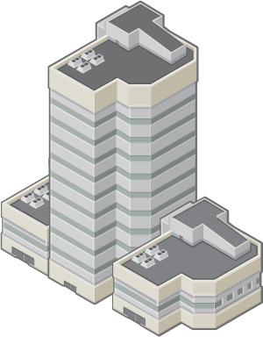
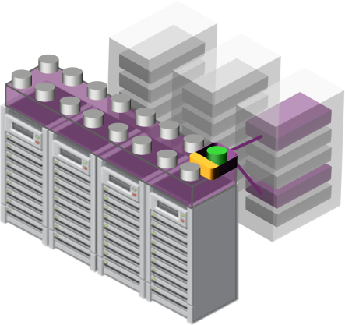
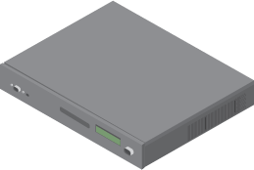
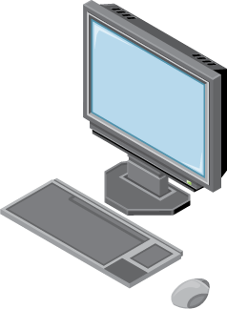
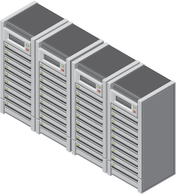
We Enable Transition to vDCs/Cloud
Customer On-Premises
Database
Virtual Storage
FS
Database
Virtual Instances
WA
File Shares
File Shares
Application Servers
Application Servers
Storage

Slide 22
Customer On-Premises
We Enable Transition to vDCs/Cloud
Virtual Storage
MF
FS
WA
Database
Virtual Instances
Mainframe
File Shares
Application Servers
On-Premises Key Management
Maintains control (Separation of duty)
Maintains visibility (& ‘Auditability’)
EAL & FIPS level of key security & management

Slide 23
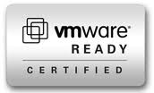
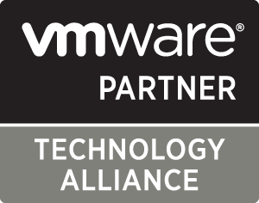
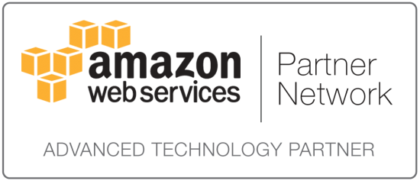
Introducing ProtectV….
ProtectV is the industry’s first comprehensive high-assurance solution for securing both virtualization and cloud infrastructure.
This gives you the freedom to migrate to virtual and cloud environments while maintaining full visibility, control and security of data.
Notes:
ProtectV
We have so far discussed various mandates, security challenges, some mitigation strategy at length, let me very briefly introduce ProtectV: Data Protection For the cloud as a mechanism to address some of the risks and security issues.
ProtectV is the industry’s first comprehensive high-assurance solution for securing both virtualization and cloud infrastructure.
This gives you the freedom to migrate to virtual and cloud environments while maintaining full visibility, control and security of data.

Slide 24
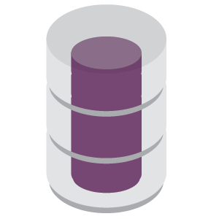
ProtectV for Securing the Virtual Infrastructure
Data used by financial app
App
App
App
App
App
App
App
OS
OS
OS
OS
OS
OS
OS
Data copied into OS partition’s RAM - encrypted
Hypervisor
Hardware Layer
Storage
Data copied into storage - encrypted
Backup
Data copied in hourly snapshot - encrypted
Snapshots
ProtectV Enables Customers to Migrate Compliant Data to vDCs / Cloud
Notes:
Data Protection for the cloud with ProtectV
This is the same slide with data in different stages of its life cycle, but now protected with SafeNet ProtectV. Now your data is protected.
In next few slides, I am going to cover how this is done.

Slide 25
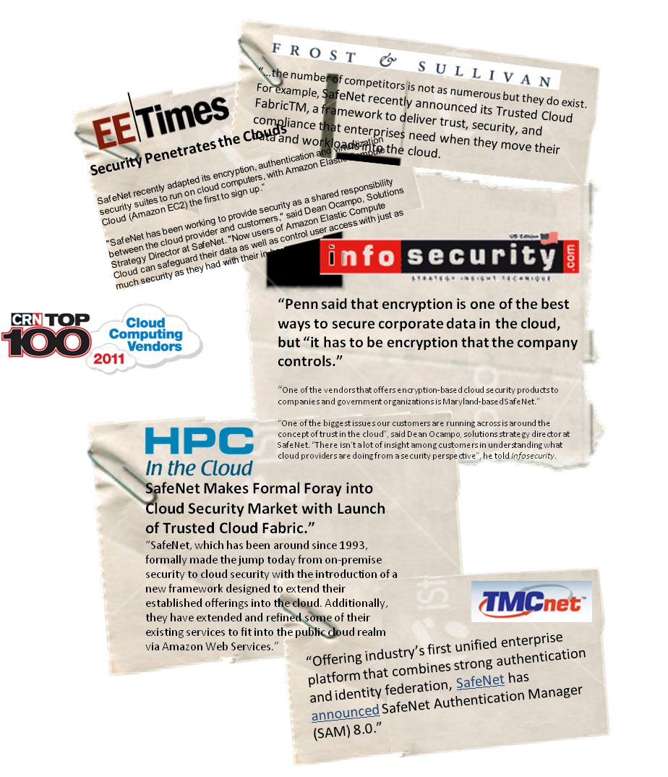
Questions?
SafeNet, Inc. | www.safenet-inc.com
Notes:
Thank you very much for attending today’s webinar. Hope you found this information useful and the information is helpful in crafting your cloud and virtualization security strategy. Please reply to the thank you email to receive a pdf copy of the presentation. Also, please do not hesitate to reach out to us should you have any questions. If you would like to find additional information, please go to www.safenet-inc.com. Please do take a moment to provide your feedback on the webinar. Thank you once again and have a great rest of the day.

